Slide 1
Chapter 10 The Senses
Touch, Vision, Smell, Balance, Hearing

Slide 2
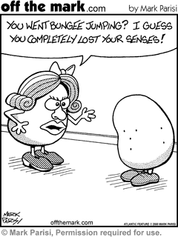

Slide 3
Introduction
Sensory Receptors
Detect environmental changes and trigger nerve impulses that travel on sensory pathways to the CNS for processing and interpretation.
Two Categories
General Senses
Receptors widely distributed throughout skin and deeper tissues; structurally simple
Special Senses
Complex, specialized sensory organs

Slide 4
Receptors
Types of Receptors (5 Categories)
Chemoreceptors
Stimulated by changes in certain chemicals
Pain Receptors
Stimulated by tissue damage
Thermoreceptors
Stimulated by changes in temperature
Mechanoreceptors
Stimulated by changes in pressure or movement
Photoreceptors
Stimulated by light energy

Slide 5
Sensations, Perception, and Projection
Sensation
Occurs when sensory receptors reach threshold and the resulting action potential causes the brain to become aware of that sensory event (All depends on region of brain that receives impulse)
Perception
Occurs when the brain interprets those sensory impulse
Example:
Pain is sensation; realizing you just stepped on a tack is perception
Not all receptors trigger sensation-Blood oxygen levels
Projection
Occurs when brain projects the sensation back to its apparent source; allows person to perceive the region of stimulation (occurs same time as it takes a sensation to form) (Ex: Eyes see, Ears hear…)

Slide 6
Sensory Adaption
Brain must prioritize
Would be overwhelmed with unimportant info otherwise
Adaption
The ability of the nervous system to become less responsive to a maintained stimulus.
Examples: Pressure of clothing on skin, back ground noise in room, candle burning after a time

Slide 7
General Senses
Wide spread, receptors associated with skin, muscles, joints and viscera (organs)
3 Types
Touch and Pressure
Temperature
Pain

Slide 8
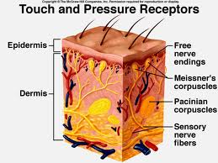
Sense of Touch and Pressure
3 kinds of mechanoreceptors
Free nerve endings
Common in epithelial tissues
Responsible for itching
Tactile (Meissner’s) corpuscles
Abundant in hairless areas of skin, respond to very light tough
Found in connective tissue
Lamellated (Pacinian) corpuscles
Found in deeper dermal, sub. Q. tissues, tendons, and ligaments
Respond to heavy pressure

Slide 9
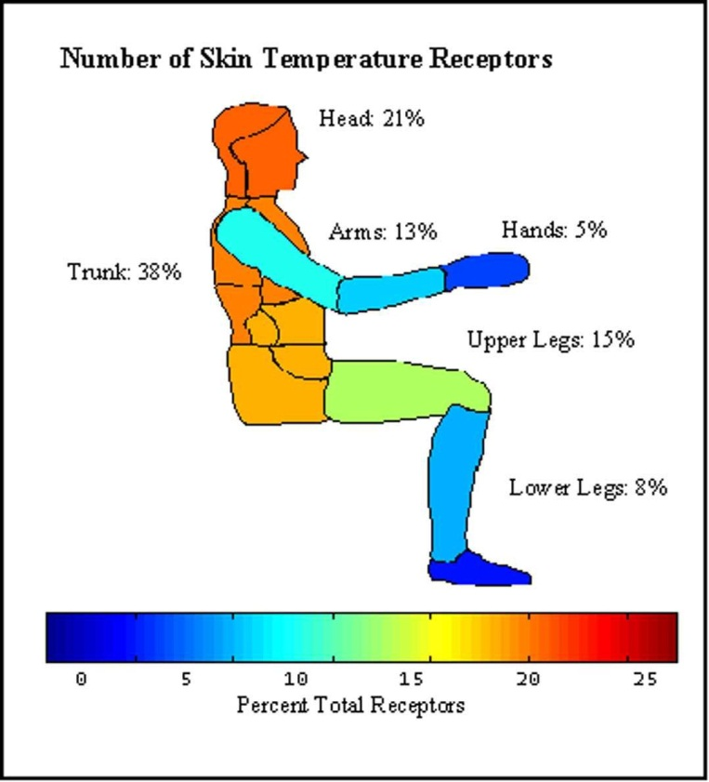
Temperature Senses
2 Types of free nerve endings
Warm Receptors
Respond to warm temps. (mostly above 77º F. and unresponsive at 113º F.)
Above 113 stimulates pain receptors producing burning sensation
Cold Receptors
Respond to cold temps. (mostly between 50º F and 68º F)
Below 50 stimulates pain receptors producing freezing sensation
Both adapt rapidly, within 1 min. of continuous stimulation, the sensation begins to fade.

Slide 10
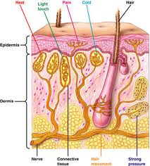
Sense of Pain
Free nerve endings found widely throughout skin and internal tissues.
Except in nervous tissue of brain
Protect body
Adapt poorly
Once activated, doesn’t usually quit right away

Slide 11
Visceral Pain
Pain receptors are the only receptors in viscera that produce sensations.
Referred Pain
Viscera pain coming from a part of the body other than what is being stimulated
Example: Heart attack felt in left arm
Happens because the nerve pathways in which the heart traels on are the same as those that arise from the skin of the left shoulder and upper limb. The Cerebral Cortex incorrectly interprets the source of pain.

Slide 12
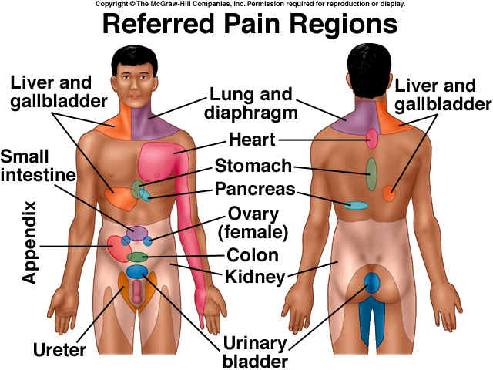

Slide 13
Pain Nerve Fibers
Acute Pain Fibers
Myelinated
Sensation of sharp pain
Seldom continues after the pain-producing stimulus stops
Chronic Pain Fibers
Unmyelinated
Impulse conducted slowly so you get a dull, aching sensation
Continues after some time once stimulus has ceased

Slide 14
Regulation of Pain Impulses
Awareness of pain arises once impulse reaches Thalamus
Cerebral Cortex determines pain intensity, locates pain source and mediates emotional and motor responses
Neuropeptides-Released in response to extreme pain
Enkephalins-suppress acute and chronic pain relieving severe pain (Natural Morphine)
Serotonin-stimulates other neurons to release enkephalins
Endorphins-produced by pituitary glad and hypothalamus, also pain-suppressing

